Slide 1
Session 9

Slide 2
Content of session
1
2
2D & 3D
Dive into 3D world
3
4
Character Controller
Assets

Slide 3
1
2D & 3D

Slide 4
Nodes

Slide 5
Nodes
Equivalent nodes:
Area2D -> Area3D
Camera2D -> Camera3D
Character body2D -> Character body3D
Collision Shape2D -> Collision shape3D
Audio Stream2D -> Audio Stream3D
Non-Equivalent nodes:
Timer
Animation Player

Slide 6
Position

Slide 7
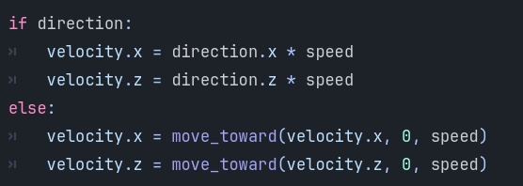
Position
Z-axis

Slide 8
Character Animation

Slide 9
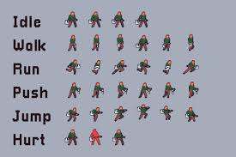
Character Animation
Images (Sprite Sheet)
❌

Slide 10
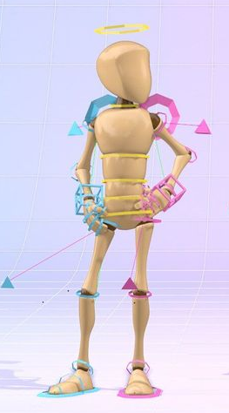
Character Animation
Models

Slide 11
Character Animation
Models contains:
Meshes : The 3D shape or geometry of an object made of vertices, edges and faces.
Textures : Image applied to a mesh’s surface to give it details (color, pattern)
Materials : Defines how meshes looks (color, texture, etc.)
Rig : The Skeleton or bone structure used for animating a 3D models
Animation : A sequence of movements or transformations applied to a model or its rig

Slide 12
2
Dive into 3D world

Slide 13
Controls

Slide 14
Controls
Action | shortcut
Rotate around object | Middle mouse
Pan (move view) | Shift + middle mouse
Move camera freely (fly mode) | Right mouse +WASDEQ
Move faster/slower in fly mode | Shift (faster)/Alt (slower)
Focus selected object | F
Change camera speed | Scroll wheel
Toggle local/global transform | T

Slide 15
Local and global transform

Slide 16
Local and global transform
Local mode: move object with the axes of the object itself.
Global mode: move object with the axes of the world object is in.

Slide 17
Grey Boxing

Slide 18
Grey Boxing
CSG Nodes: a node that allow you to make a complex shapes by combining shapes like cubes, spheres and cylinders. You can use this to make a prototype for the level you want make.

Slide 19
Grey Boxing
Types of CSG Nodes:
CSGBox: a box shape.
CSGCylinder: a cylinder shape.
CSGSphere: a sphere shape.
CSGPolygon: a polygon shape.
CSGMesh: a mesh shape.
CSGTorus: a torus shape.
CSGCombiner: a node that combines multiple CSG nodes into one shape.

Slide 20
Hands on

Slide 21
Where is the level??

Slide 22
We need:
Camera -> add camera3D for your scene.
Directional Light -> add Sun to your scene.
World Environment -> add environment.

Slide 23
3
Character Controller

Slide 24
Character Controller
What should It contain :
Camera -> FPS or TPS or move freely ?
Double jump ?
Wall jump ?
Shoot ?

Slide 25
4
Assets

Slide 26
Assets
Supported assets extension:
.FBX
.gltf -> best for godot
.glb -> binary version of gltf
.OBJ
.DAE
.blend -> blend files but should have blender installed

Slide 27
Assets
Materials types:
Wood
Metallic
Glass
Plastic

Slide 28
Assets
Most important materials :
Albedo: color using RGB and alpha for transparency.
Metallic: how metallic the surface is. (1 channel)
Roughness: how rough or smooth the surface is. (1 channel)
Ambient Occlusion: how much ambient light reaches the surface. (1 channel)
Normal Map: used to add details and depth to the surface.
Emission: how much the surface emits light form itself.

Slide 29
Assets
ORM (Occlusion, Roughness, Metallic):
We can use it with ORMMaterial3D Node instead of using occlusion, roughness and metallic separately as all of them have 1 channel.

Slide 30
Assets
.gltf object include all of materials, texture inside it and can be extracted in separate files in addition to the object itself.

Slide 31
Thanks!
Any Questions

